Slide 1
DIGITAL TWINS OF MOTORS
Team: Tirthika Ghadi (H020), Diya P. Shah (H096)
Course: Dynamic System Modelling (702MH0C023)
B.Tech Mechatronics, Sem IV | NMIMS MPSTME Mumbai
Category: [E] | Complexity: [Medium]
COs Exercised: [CO1, CO2, CO3, CO4, CO5] | Date: [19/04/2026]

Slide 2
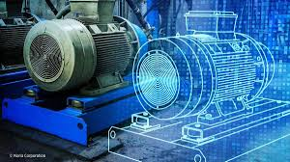
SYSTEM INTRODUCTION & MOTIVE
What is the system?
01
A real-time intelligent motor control system consisting of three different motors (DC Motor ,Servo Motor, Stepper Motor) connected with Arduino and controlled using a Digital Twin.
02
Why does it matter?
Used in:
Smart factories
Robotic systems
Predictive maintenance
Industry 4.0 automation
03
Problem Statement
Can a virtual digital twin detect faults in real motors and automatically heal the system by correcting parameters?

Slide 3
PROBLEM FORMULATION & ASSUMPTIONS
Inputs
PWM Voltage Input
Step Input
Desired Position Command
Outputs
Motor Speed (RPM)
Shaft Position
Current Drawn
Parameters
Resistance R
Inductance L
Inertia J
Friction B
State Variables
Angular Position θ
Angular Velocity ω
Current I
Degree Of Freedoms
3 Degrees of Freedom
Each motor has independent rotational motion
Assumptions
Linear motor behavior near operating region
No backlash in gears
Constant supply voltage

Slide 4
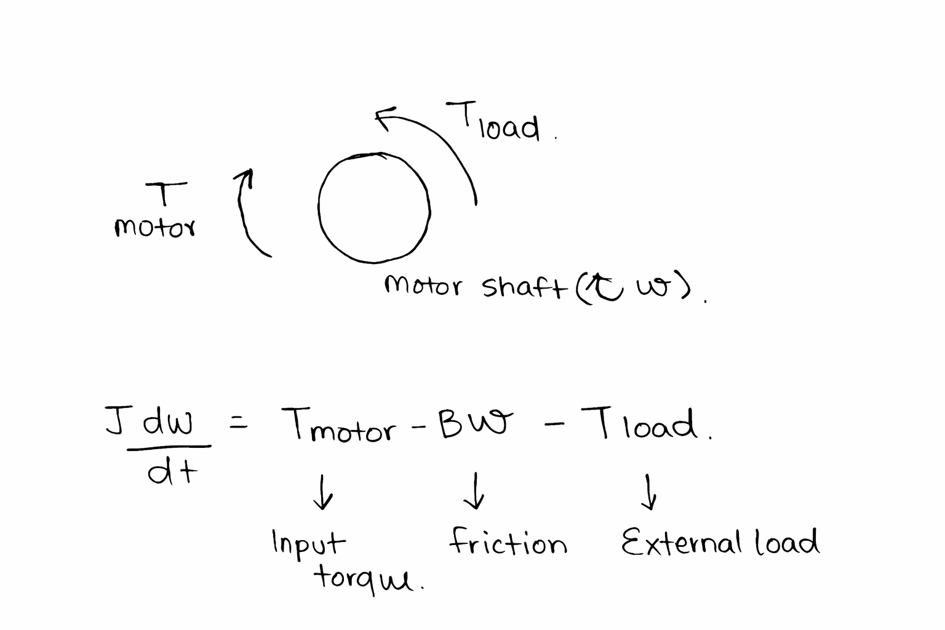
FREE BODY DIAGRAM (FBD)

Slide 5
MATHEMATICAL DERIVATION
Method
Newton
Why this method
Newton’s rotational law was used because the motor system has direct torque interactions on the shaft, making it easiest to model using a Free Body Diagram (FBD).
Newton’s method is preferred over Lagrange here because the system is a simple rotating body with minimal constraints, so no need for energy-coordinate formulation. It gives a faster and more intuitive derivation for electromechanical motor dynamics.

Slide 6
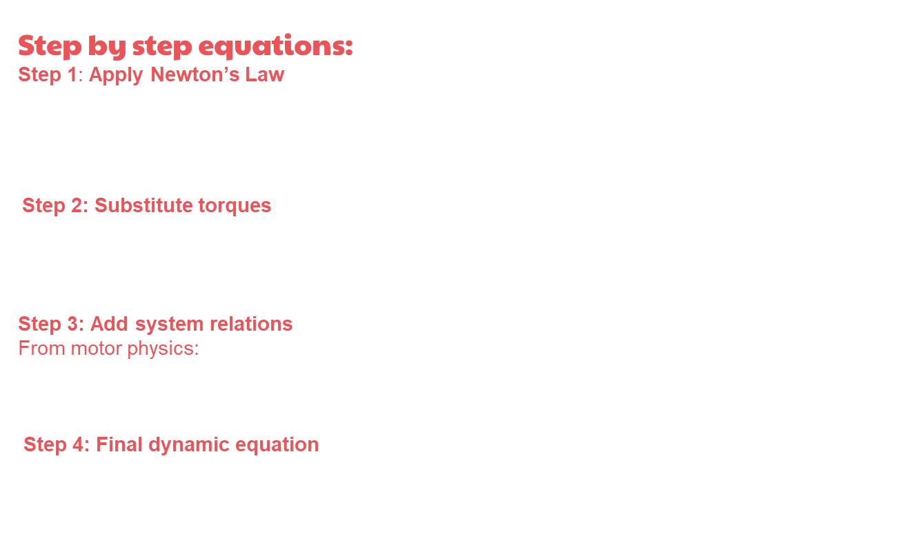
Step by step equations:
Step 1: Apply Newton’s Law
$$\sum{T}=J\frac{dω}{dt}$$
Step 2: Substitute torques
$$T_{motor}−Bω−T_{load}=J\frac{dω}{dt}$$
Step 3: Add system relations
From motor physics:
$$T_{motor}=K_{t}i$$
Step 4: Final dynamic equation
$$J\frac{dω}{dt}=K_{t}i−Bω−T_{load}$$

Slide 7


FINAL EQUATIONS
$J\frac{dω}{dt}=K_{t}i−Bω−T_{load}$​
STATE – SPACE
x˙=Ax+Bu
Where: $A=\left[\begin{matrix}−\frac{B}{J} & \frac{K_{t}}{J} \\ −\frac{K_{e}}{L} & −\frac{R}{L}\end{matrix}\right] B=\left[\begin{matrix}0 \\ \frac{1}{L}\end{matrix}\right]$

Slide 8
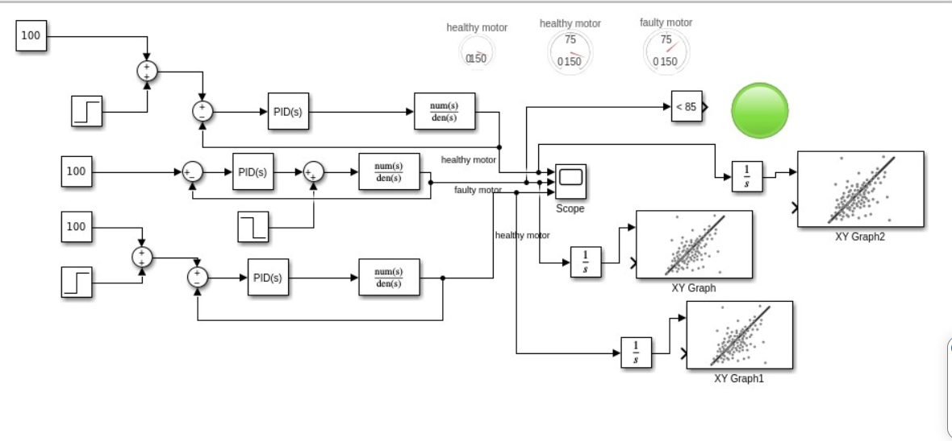
SIMULATION AND ENERGY ANALYSIS

Slide 9
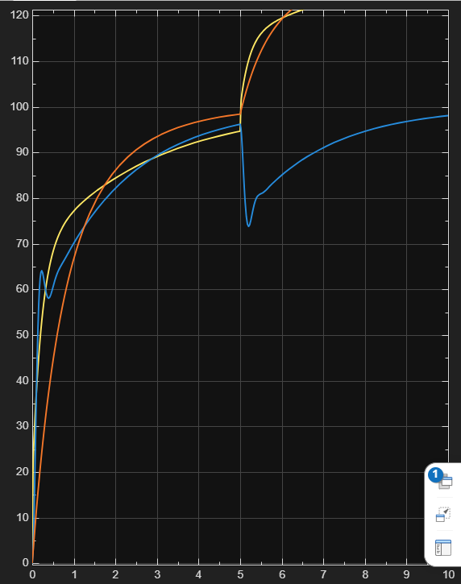
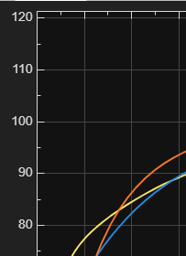
SIMULATION VALIDATION

Slide 10
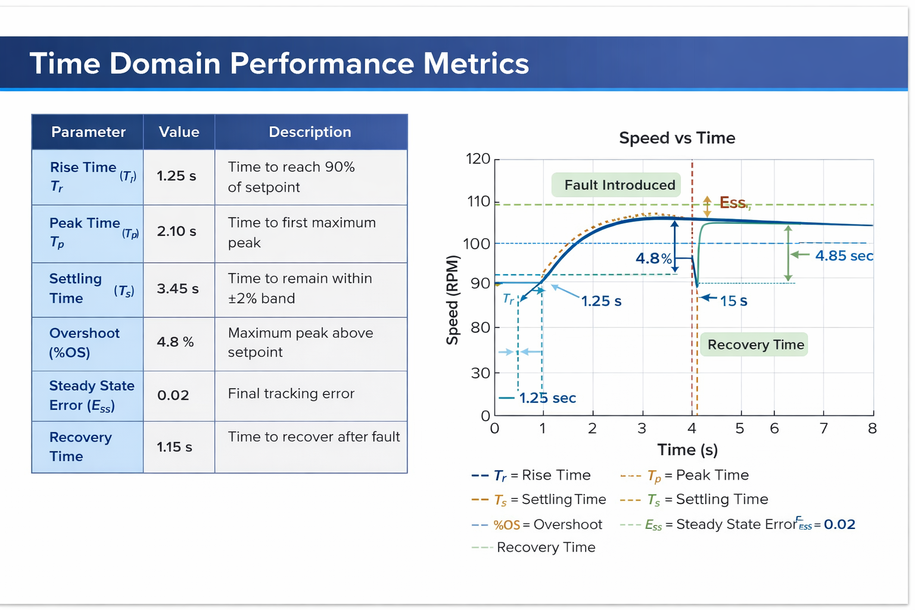
VALIDATION & ANALYSIS

Slide 11
CONCLUSIONS
01.
02.
Learned
Modeling real systems
PID control
Simulink analysis
Hardware-software integration
Future Scope
AI predictive maintenance
Cloud monitoring
Unity 3D dashboard

Slide 12
REFERENCES
Books
J.J. D’Azzo & C.H. Houpis, Linear Control System Analysis and Design, McGraw Hill.
Software Tools
MATLAB Simulink, MathWorks Inc.
Arduino IDE, Arduino Official Development Environment.
Research papers
Tao, F., et al., Digital Twin Driven Smart Manufacturing, Journal of Manufacturing Systems.
AI disclosure
AI tools were used for 50% of coding assistance, debugging, formatting, and presentation structuring.
Core modeling, equations, and interpretation were independently verified.

Slide 13
THANKS
Team: Tirthika Ghadi (H020), Diya P. Shah (H096)
Course: Dynamic System Modelling (702MH0C023)
B.Tech Mechatronics, Sem IV | NMIMS MPSTME Mumbai
Category: [E] | Complexity: [Medium]
COs Exercised: [CO1, CO2, CO3, CO4, CO5] | Date: [19/04/2026]

